Slide 1

Home Automation System
Final Evaluation
Presenter
Hrithik Sharma(2020a1r034)
CSE - 5th Semester
Guide:-
Ms. Mekhla Sharma
DEPARTMENT OF COMPUTER SCIENCE AND ENGINEERING
MIET(Autonomous), JAMMU

Slide 2
Contents
Learnings
Introduction
Problem Statement
Solution
Tech Stack
Features
Workflow
Demonstration

Slide 3
What we have learnt?
Python:-
Data type
Array
List
Tuple
Functions
IOT(Internet Of Things):-
Sensors
Raspberry pi
Libraries Used :-
Spidev
Port
Pio
GPIO(General purpose input output)

Slide 4
Introduction:-
What is Home Automation?
It is automation of the home ,housework or household activity.
It may include centralized control of lighting, HVAC (heating, ventilation and air conditioning), appliances, security locks of gates and doors and other systems.
It is used to provide improved convenience, comfort, energy efficiency and security.

Slide 5
Problem Statement
The Problem Statement is to automate the home to do task more efficiently.
To Control the home appliances by using computer technology.
To enhance security.
To Save electricity

Slide 6
Solution
Our system would be able to detect the person.
Our system can automatically turn on or off the light.
It can automatically generate a sound and message the owner in case of fire accident at home.
Automatic Fan System(Turn On/Off)

Slide 7
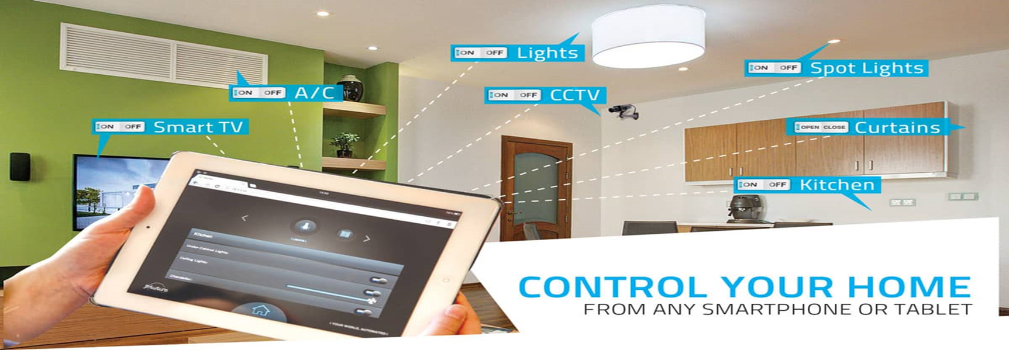
Example:-
Source Used:- https://www.archute.com/10-benefits-automating-home/

Slide 8
Tech Stack
Python(Program)
Proteus 8 Professional(Simulation Software)
Raspberry pi
Libraries Used:-
spidev
Rpi.GPiO
Pio (Programmable input output pins)
Ports
LCD
Sensors
PIR Sensor(Passive infrared sensors to detect heat energy.)
LDR Sensor(Light Dependent Sensor)
ADC Module
Buzzer

Slide 9
Features
Automate temperature
Detect person
Automate bulb
Automate Light Intensity
Give Warning in case of fire incident:-
Sounding Buzzer
Message the owner about the incident

Slide 10
WORKFLOW

Slide 11
PIR Sensor
Display Turning On/Off Bulb
Display Turning On/Off Fan
Display Warning Message
LCD Circuit
Detect Person
Turn On/Off Bulb
Turn On/Off Fan/AC
Sound Buzzer and message a number
Signal Raspberry pi
Check Light Intensity
Check Temperature
Detect Gas/Smoke
Convert analog to digital signal
Instruct all sensors and circuit
LDR Control Circuit
Temperature Sensor
Gas Sensor
ADC Module

Slide 12
DEMONSTRATION

Slide 13
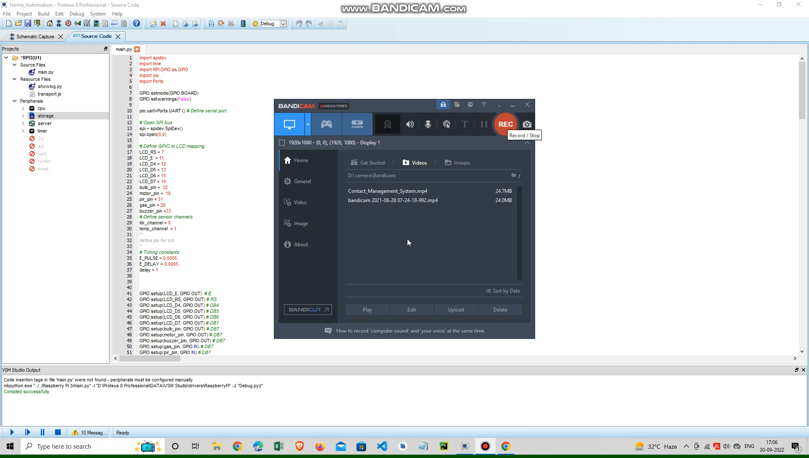

Slide 14
Sources Used:-
https://www.archute.com/10-benefits-automating-home/

Slide 15


